Slide 1
Infrastructure-as-a-service (IAAS) vs. Platform-as-a-service (PAAS) vs. Software-as-a-service (SAAS)

Slide 2
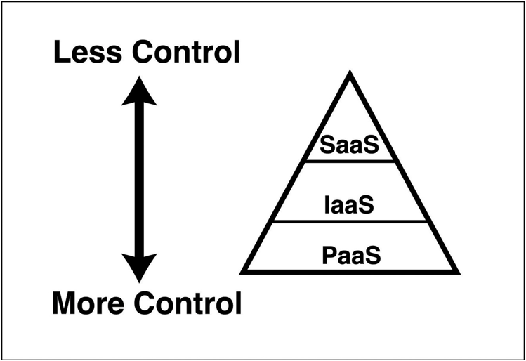
Executive summary
Source: …

Slide 3
Agenda
Chapter

Slide 4
Infrastructure-as-a-Service (IaaS)

Slide 5
Platform-as-a-Service (PaaS)
A cloud provider still provides the infrastructure for you, but they also provide the operating system, software installed in the operating system to help you connect to databases and network systems (often referred to as middleware), and many features that enable you to build and manage complex cloud applications
PaaS services offer you the flexibility of controlling the application, but they offload management and control of the underlying systems to the cloud provider. If you are deploying your own application to the cloud and you want to minimize your management investment, a PaaS service is often the best choice.
One more interesting thing is the option to publish either your code or a Docker image.
The cloud provider usually provides multiple versions of each framework so you can choose a version that you know is compatible with your application.
Provide additional capabilities to you by adding their own features, e.g.: log in with a Microsoft account, a Facebook account, or a Google account.
A PaaS service also benefits from all of the other enhancements offered by the cloud; you get fault tolerance, elasticity, easy and quick scaling, backup and disaster recovery features, and more

Slide 6
Software-as-a-Service (SaaS)
SaaS services are quite a bit different than IaaS or PaaS services because they are completely managed and maintained by the cloud provider. You don’t have the option of installing any of your own software with a SaaS service, so the deciding factor is related entirely to whether or not the provided-software meets your needs.
Benefits:
largely removes the IT burden from your company.
enables everyone in your company to access the software on multiple devices from just about anywhere Internet access is available.
benefit from data backup that the cloud provider includes in their infrastructure
Drawback: If you have a need to customize the application or have any control over its configuration, however, SaaS may not be a good choice for you

Slide 7
Serverless
In the platform as a service model, you do have some concept of how many instances and what your performance expectations are. But in the Serverless model, it's just even less so. You don't have as much access to control performance in the platform as a service model. One of the foundational elements in Azure is called the App Service Plan.
But in the platform, as a service model, you're choosing a tier, you're choosing the basic tier, the standard tier and the premium tier, and you're also choosing plan levels within those. So standard one, standard two, standard three. And so you're going to get double the performance like two is double the performance of S1 and as three is double the performance of S2 and the features are pretty much the same between them except for the performance.
So in the past model, you do have that control over how much horsepower is running your apps. In Serverless model, you're just handing it over and you're paying on a different level also with the pass model. The concept of scaling is your responsibility. So if you want your application to pay attention to the CPU utilization and then add instances when the CPU starts to get hot, that would be the past model. In the serverless model, the cloud provider takes that responsibility.
So you given the code and they will add servers as they need to.
There is sort of a benefit to Serverless, which is you don't even have to worry about choosing the right plan when you're sitting in front of the computer and you're trying to set this up and you're like, oh, do I need the S2 or should I go for the S3 just in case? So Serverless is even closer to that ideal of leaving things to the cloud and only paying for what you need. You're not worrying about scaling. You're not trying to set up the right rules in terms of is it 70 percent CPU or 75 percent? When do you scale back another benefit to the server? This model is there's also a chance of paying nothing. So if you load a website into a Serverless app and no one ever visits it, your bill can come back literally as zero dollars because you're only paying for execution and you're not paying for the reservation of that. So in an app service or platform as a service, you're paying by the hour. And if no one ever visits your website, you're still paying.
Serverless model is you're basically paying not by the visit, but by the CPU utilization and even by data utilization. So if we look at Microsoft Azure, more specifically, there are different Cervalis offerings.
Now, this isn't the Azure part of the course, but I will mention you can get Azure functions. There is a Serverless Kubernetes offering, which is the container services, there are database serverless options and even a Cosmos DB serverless.
So you got different database and compute serverless offerings that you can go to, which again could drive your bills down to very low. But then you also could have an unexpected bill because you're not picking a plan. It's taking over for you.

